Slide 1
STUDENT LEARNING MODELS Review-1
Department of Information Technology
Deep Learning Framework for Speech to Text Conversion in Dysarthric patients
Under the Guidance
of
Mrs. C. S. L. Vijaya Durga
Batch Number: 08
24951A1256 - T. NAVANEETH REDDY
25955A1203 - D. MADHU

Slide 2
Abstract
Dysarthria is a motor speech disorder that affects a person’s ability to articulate speech clearly, making conventional speech-to-text systems ineffective.
This project proposes a deep learning–based speech-to-text framework designed specifically for dysarthric speech.
By leveraging advanced neural network architectures and tailored preprocessing techniques, the system aims to improve transcription accuracy and enhance communication accessibility for dysarthric patients.

Slide 3
Introduction
Speech-to-text technology has become an essential component of modern human–computer interaction, enabling voice-based communication in applications such as virtual assistants, accessibility tools, and healthcare systems. However, most existing automatic speech recognition (ASR) systems are designed and trained using speech data from healthy speakers. As a result, they perform poorly when applied to individuals with speech disorders. Dysarthria is a motor speech disorder caused by neurological damage that affects muscle control required for speech production. These characteristics significantly degrade the performance of conventional ASR systems, making them unreliable for dysarthric patients.

Slide 4
Introduction
The inability of standard speech-to-text systems to accurately recognize dysarthric speech creates a major communication barrier for affected individuals, limiting their independence and access to digital technologies. Recent advances in deep learning have shown strong potential in modeling complex, non-linear patterns in speech signals, particularly in handling variability and temporal dependencies. This project focuses on developing a deep learning framework specifically designed for speech-to-text conversion in dysarthric patients, with the goal of improving transcription accuracy and enhancing assistive communication support.

Slide 5
Problem Identification
Dysarthric patients face difficulty using standard voice-based systems
High word error rates in conventional ASR models
Limited datasets and poor model generalization
Lack of personalized and adaptive speech recognition systems
Problem Statement : To develop an accurate and reliable speech-to-text system tailored for dysarthric speech.

Slide 6
Objectives
Design a deep learning framework for dysarthric speech recognition
Preprocess and enhance dysarthric speech signals
Extract robust acoustic features
Train a neural network model for speech-to-text conversion
Improve transcription accuracy compared to traditional ASR systems
Enable assistive communication for dysarthric patients

Slide 7
Literature Review
2024 research shows deep learning models significantly outperform HMM-based ASR for dysarthric speech [HMM - Hidden Markov Model]
Transformer and CNN-RNN hybrid architectures improve robustness to articulation variability
2025 studies emphasize speaker-adaptive and transfer learning techniques
Recent work highlights the importance of data augmentation for limited dysarthric datasets
Identified Gap : Most systems lack generalization across severity levels and real-world usability.

Slide 8
Authors | Published Year | Paper Title | Key Findings
Zhang et al. | 2024 | Deep Learning Approaches for Dysarthric Speech Recognition Link - https://arxiv.org/pdf/2501.03536v1 | The study demonstrates that deep learning models significantly outperform traditional HMM-based ASR systems for dysarthric speech. CNN and LSTM [Long Short Term Memory] architectures showed improved robustness to articulation variability, resulting in reduced word error rates for disordered speech.
Kim and Lee | 2024 | Transformer-Based ASR for Disordered Speech Link - https://link.springer.com/article/10.1186/s13636-024-00368-0 | This paper highlights the effectiveness of Transformer-based architectures in modeling long-range temporal dependencies in dysarthric speech. The approach achieved higher transcription accuracy compared to RNN-based models, especially for moderate to severe dysarthria.

Slide 9
Authors | Published Year | Paper Title | Key Findings
Patel et al. | 2024 | Robust Acoustic Modeling for Pathological Speech Recognition Link - https://www.sciencedirect.com/science/article/pii/S0885230825000646 | This research focuses on robust acoustic feature modeling techniques for pathological speech. The findings show that features combined with deep neural networks improve recognition performance under high speech variability and limited training data conditions.
Hernandez et al. | 2025 | Advances in Assistive Speech Technologies for Dysarthria Link - https://ceur-ws.org/Vol-3910/aics2024_p63.pdf?utm | The authors review recent advancements in assistive speech technologies and emphasize the role of deep learning in improving communication accessibility for dysarthric patients. The study identifies personalized and adaptive ASR systems as key future directions.

Slide 10
Proposed Methodology
Dysarthric speech data acquisition
Signal preprocessing and noise reduction
Feature extraction
Deep learning model training
Speech-to-text decoding
Performance evaluation

Slide 11
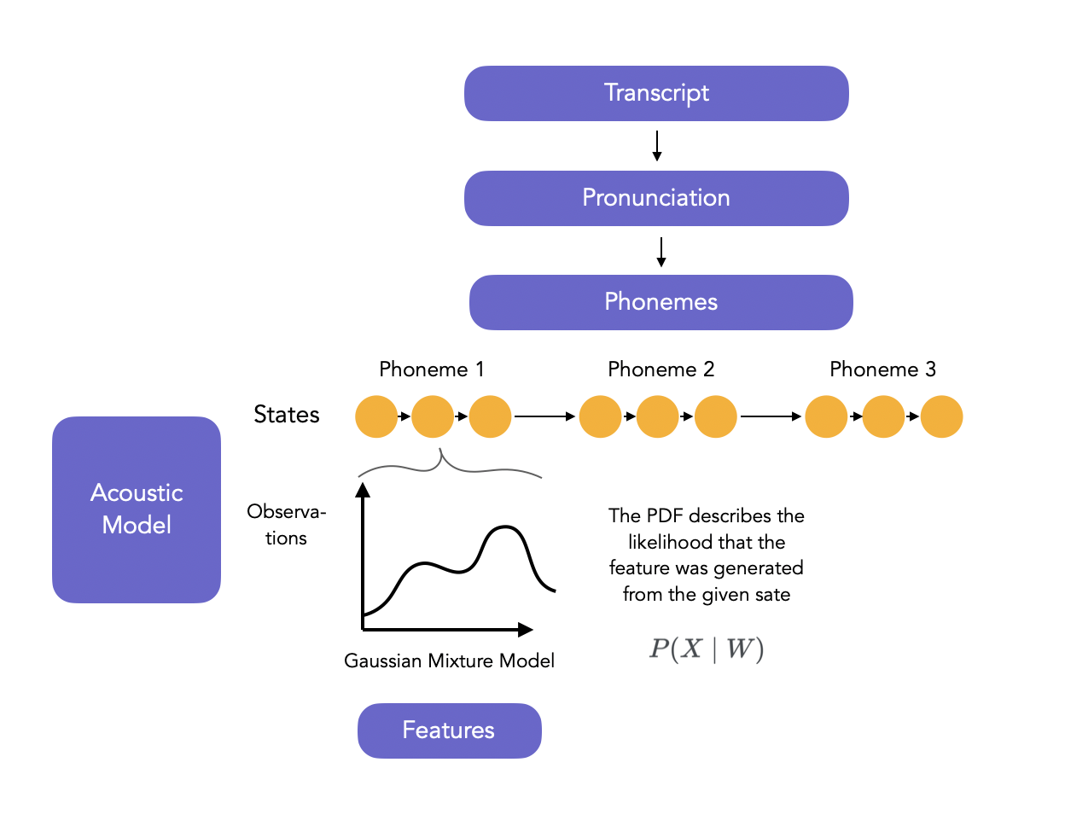
Proposed Methodology

Slide 12
Tools & Technologies
Programming Language : Python
Deep Learning Frameworks : TensorFlow / PyTorch
Speech Processing : Librosa, SpeechBrain
Feature Extraction : MFCC, Spectrogram analysis
Development Environment : Jupyter Notebook / Google Colab

Slide 13
Expected Outcomes
Improved speech recognition accuracy for dysarthric speech
Reduced word error rate compared to traditional ASR
Enhanced communication support for patients
Scalable framework adaptable to different speech disorders

Slide 14
Applications & Impact
Applications:
Assistive communication tools
Voice-enabled accessibility systems
Clinical speech therapy support
Impact:
Improved quality of life
Increased digital accessibility
Social and technological inclusion

Slide 15
Advantages of Proposed System
Tailored for dysarthric speech patterns
Deep learning–based adaptive learning
Higher robustness to speech variability
Can be extended to multilingual support

Slide 16
Conclusion
The proposed deep learning framework provides an effective and inclusive speech-to-text solution for dysarthric patients, addressing limitations of conventional ASR systems.

Slide 17
References
Deep Learning Approaches for Dysarthric Speech Recognition, IEEE Access, 2024
Transformer-Based ASR for Disordered Speech, Speech Communication, 2024
Advances in Assistive Speech Technologies for Dysarthria, Elsevier AI in Healthcare, 2025
Robust Acoustic Modeling for Pathological Speech Recognition, Sensors, 2024

Slide 18
THANK YOU

